Slide 1
jFuzzyLogic
A Robust and Flexible Fuzzy-Logic Inference System Language Implementation
Pablo Cingolani & Jesús Alcalá-Fdez

Slide 2
A picture of the Fuzzy software status

Slide 3
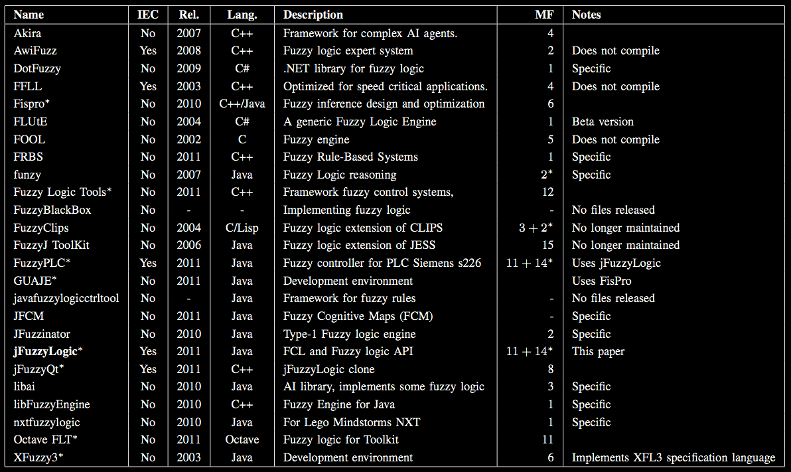
Many options…

Slide 4
…but there are some problems
No standards.
File format incompatibility: A fuzzy system created using one program doesn’t work on another one.
Every project re-writes same boilerplate code instead of focusing on new features.
Platforms incompatibilities.
Dead code: Projects that either don’t compile or haven’t released code for years.
Some licenses are: “only academic”, “the code will be provided upon request” or just unfriendly licensing schemes.

Slide 5
We need a simple solution to these problems

Slide 6
jFuzzyLogic
Standardization: reduces programming work and learning curve. Standard IEC 61131-7.
Extensibility: Object model and API allows to create a wide range of applications.
Robust For industrial application.
Open license for everyone.
Platform independent.

Slide 7
Fuzzy Control Language (FCL)
Defined by International Electrotechnical Commission (IEC)
Norm IEC-61131 defines six programming languages.
Five of this languages are used in standard Programmable logic controllers (PLC)
It also defines data types and programming modularity.

Slide 8
FCL is easy to learn

Slide 9
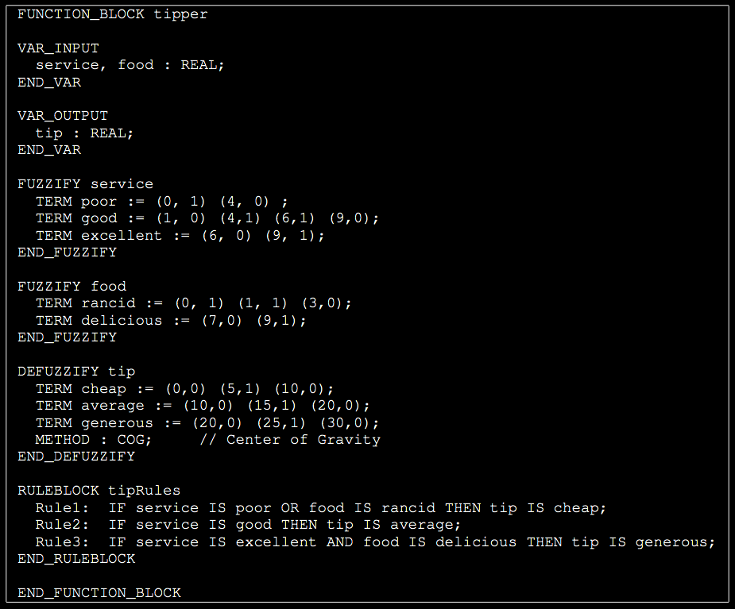
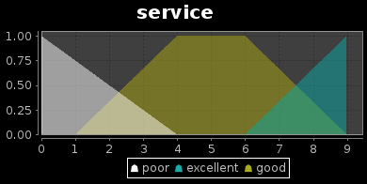
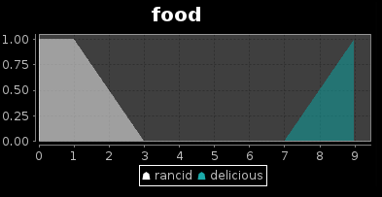
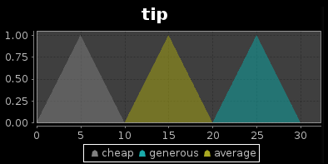
FCL example

Slide 10
jFuzzyLogic implements all FCL features

Slide 11
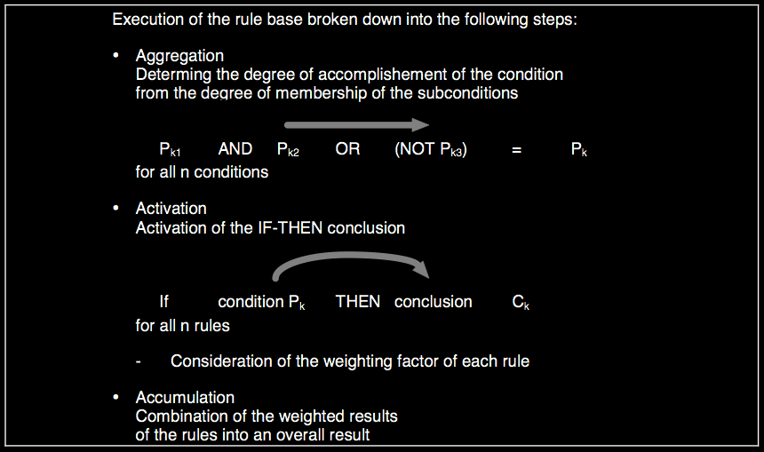
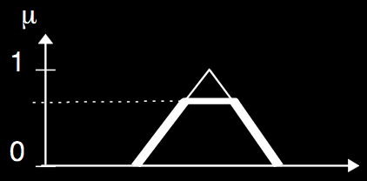
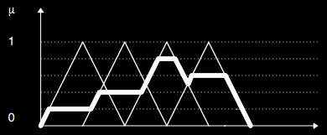
Aggregation, Activation, Accumulation
In the norm, the names used for these definition may differ from textbooks

Slide 12
Aggregation, Activation, Accumulation
Method name | Means | Implemented in jFuzzyLogic
Aggregation | How t-norms and t-conorms playing the role of AND, OR and NOT operators | Minimum, Product or Bounded difference
Activation | How rule antecedents modify rule consequents | Minimum and Product
Accumulation | How the consequents from multiple rules are combined | Maximum, Bounded sum, Normed sum, Probabilistic OR, and Sum

Slide 13
jFuzzyLogic implements extensions to the norm

Slide 14
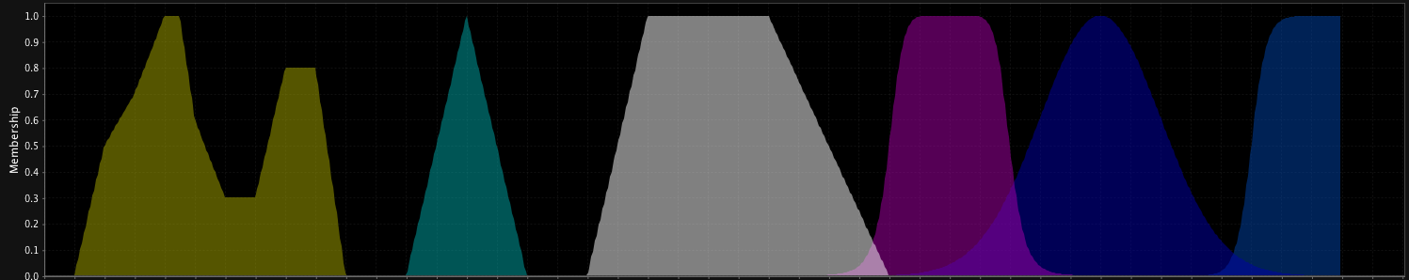
Membership functions
The norm only defines two: singleton or points
We also support: trian, trape, gbell, gauss, sigm, etc.

Slide 15
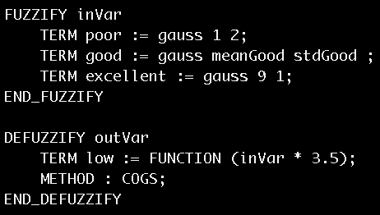
Membership functions
Support arbitrary mathematical expressions.
Membership functions can be parameterized. E.g.:

Slide 16
jFuzzyLogic is exntesible

Slide 17
Modularity: It is possible to add custom aggregation, activation or accumulation methods, defuzzifiers, or member- ship functions by extending the provided object tree.
Dynamic changes: Supports dynamic changes made onto a fuzzy inference system:
  Variables can be used as membership function parameters
  Rules can be added or deleted from rule blocks dynamically
  Rule weights can be modified dynamically
  Membership functions can use combinations of pre-defined functions.
Optimization API: An optimization API allows fine tuning membership function rules and rule weights.

Slide 18
Conclusions
jFuzzyLogic:
  Implements standard IEC-61131-7 (FCL).
  Using a standard solves the compatibility problem
  Library ready to use: Saves you time by not re-inventing the wheel.
  Extensible & Flexible: You can focus on your project.
  Robust: Currently used in industrial projects.
  Open: Friendly licensing.

